Slide 1

Web Development with Javascript
Quan Ngo Huu

Slide 2



/quan.nh.25595
/quannh25595

Slide 3
Course Overview
ReactJS
Node.JS + Express.JS
MongoDB
Socket.IO
Heroku

Slide 4
Requirement
JavaScript + HTML + CSS fundamentals are absolutely required
You DON'T need to be a JavaScript expert to succeed in this course!
ES6+ JavaScript knowledge is beneficial but not a must-have
NO prior React, Node.JS, Express.JS or any other JS framework experience is required!

Slide 5

Web Development Overview

Slide 6
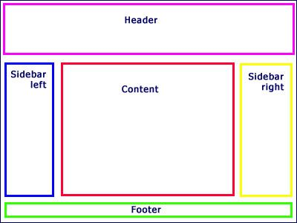
What is React
A Javascript Library for building User Interface.
Component:

Slide 7
React in Action
https://codepen.io/quannh25595/pen/ZEYyyxE

Slide 8
Why React?
UI state becomes difficult to handle with “Vanilla” JS.
Focus on Business Logic, not only the UI.
Community, Ecosystem, Performance.

Slide 9



React Alternatives

Slide 10
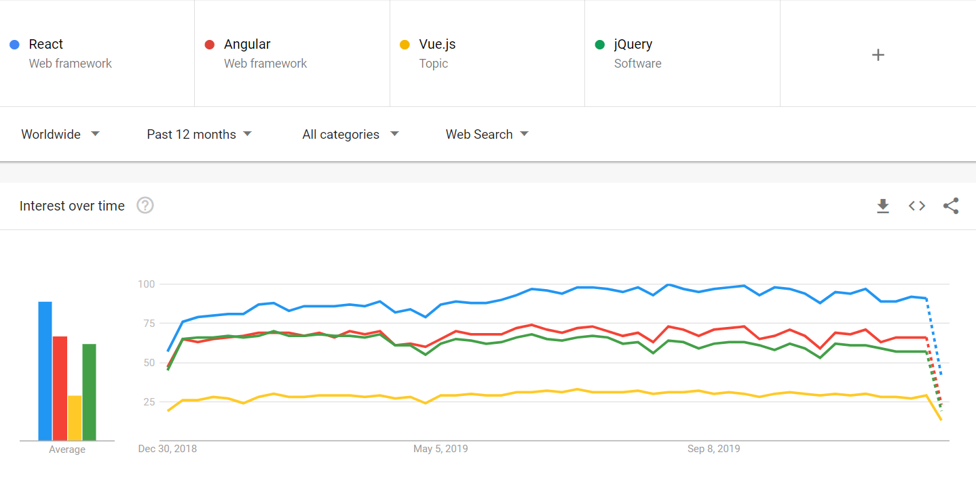
React Alternatives

Slide 11




Real-World SPAs & React Apps

Slide 12
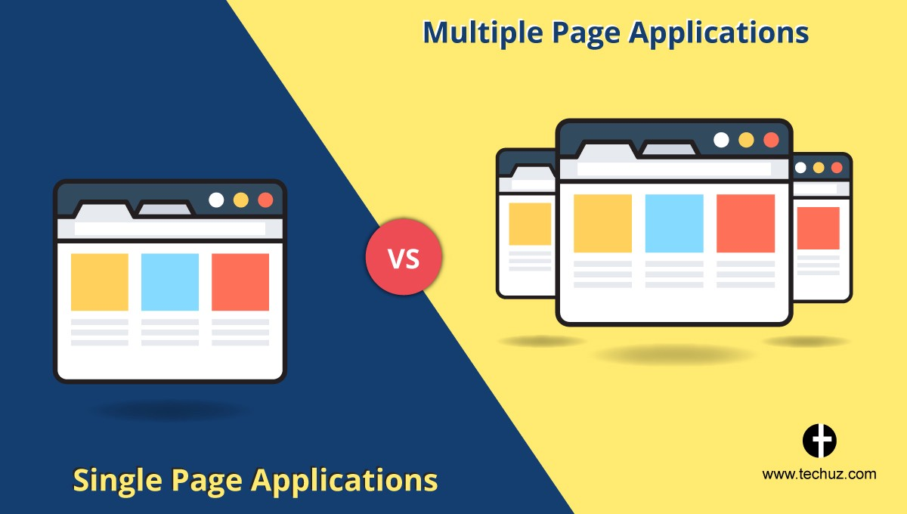
SPAs vs MPAs

Slide 13
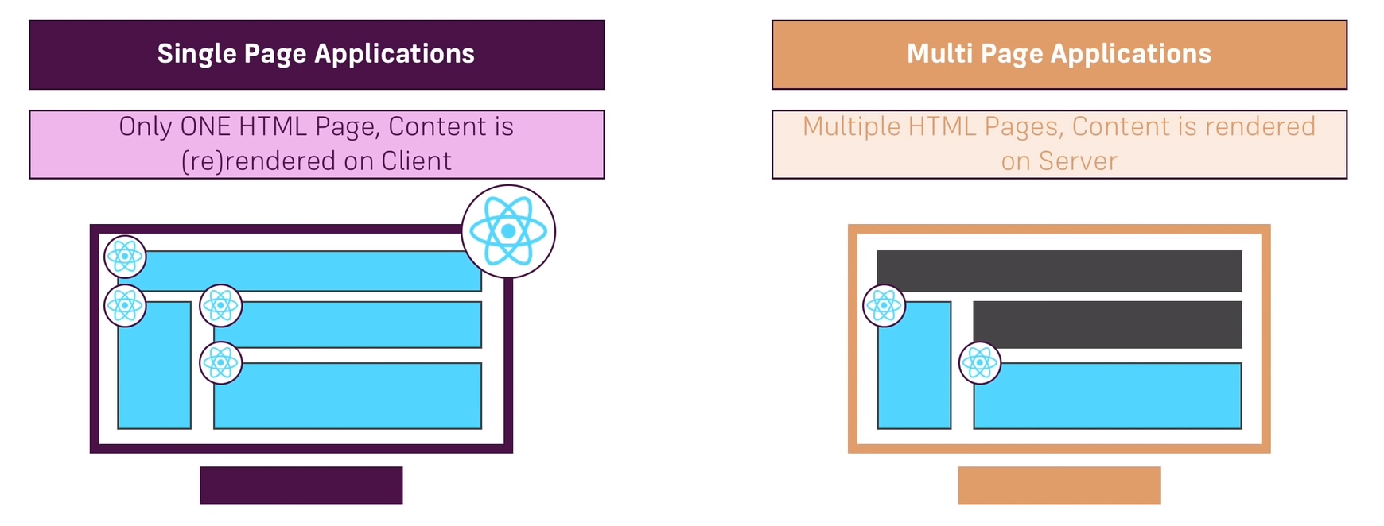
SPAs vs MPAs

Slide 14
React Outline
ECMAScript 7 (ES 7, ECMAScript 2016)
Basics
Debugging
Components
HTTP Requests
Routing
Deployment

Slide 15
ECMAScript 7
let, const
Arrow function
Exports, imports
Spread & Rest Operator
Destructuring
Refreshing Array Functions

